Slide 1
LeNet5 EEG
Ronald Broberg
Oct 27 2014
CS5870

Slide 2
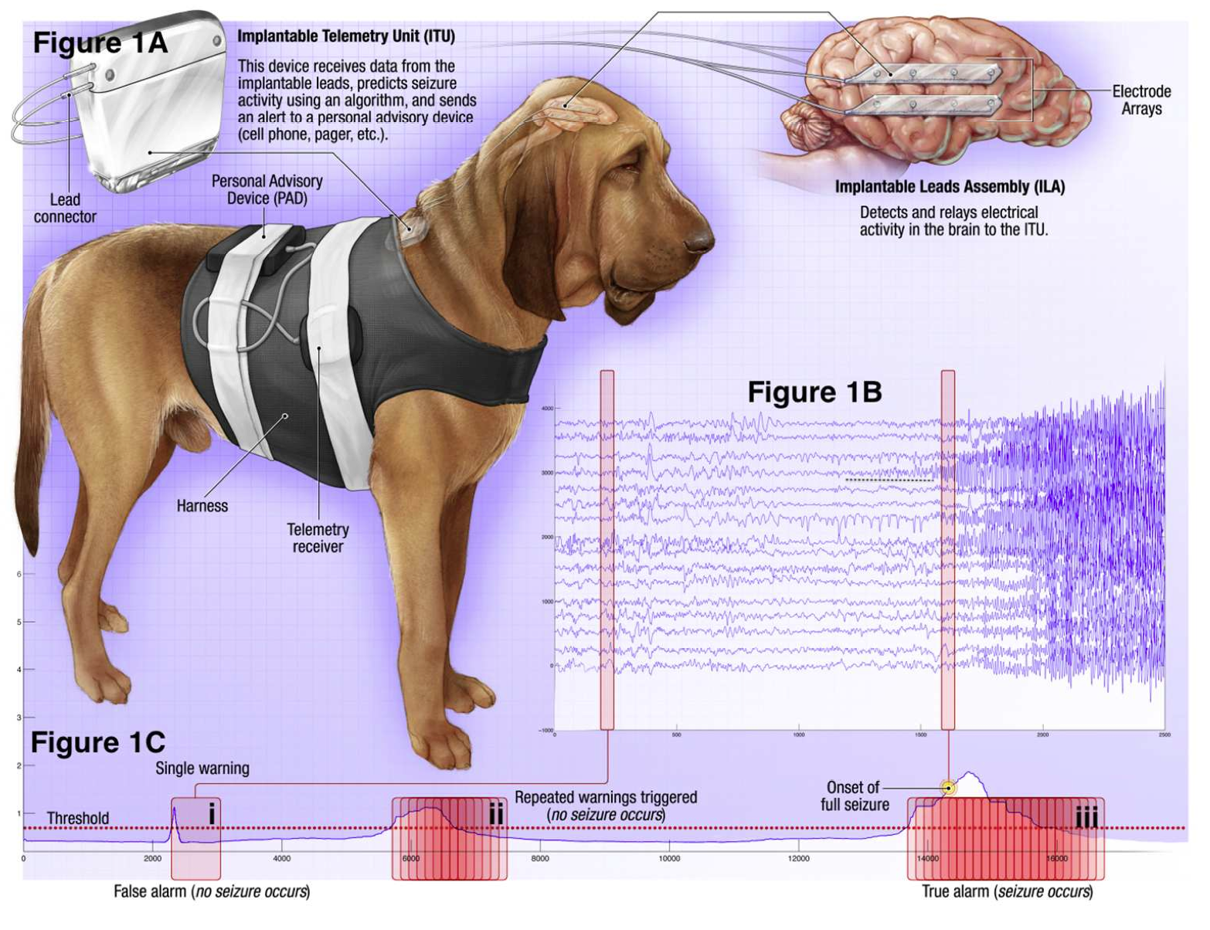
Problem
http://www.kaggle.com/c/seizure-prediction

Slide 3
Data Source
University of Pennsylvania
4 Dog
8 Human

Slide 4
ETL
Converted from MATLAB binary data storage to HDF5 format
Downsampled to 200 Hz
Features extracted with Julia ? Python
Stored as csv

Slide 5
Feature Selection
Variance
Autocorrelation
Cross-correlation
Amplitude Entropy
Skew
Heteroskedasticity

Slide 6
Model
LeNet5
Theano 0.6.0
Python 2.7.3 / gcc 4.6.3
Numpy 1.9.0 / scipy 0.14.0

Slide 7
Performance
Amazon EC2 AWS g2.2xlarge
Ubuntu 12.04.4 LTS x86_64
NVIDIA Kepler GK 104 GPU
26 ECUs
8 vCPUs
2.6 GHz
Intel Xeon E5-2670
15 GiB memory
1 x 60 GiB Storage Capacity
Theano LeNet
MNIST data set
Accuracy
0.92% on tutorial
0.92% on my setup
Speed
380.28m tutorial
552m on my setup

Slide 8
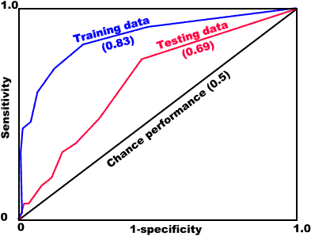

Slide 9
Results
Confusion
AUC
TP/(TP+FP)

